Slide 1

Point-of-Sale Data & How to Use It
South Carolina Department of Alcohol and Other Drug Abuse Services
Reston Hartsell, MS-MPH
Synar/Tobacco Prevention Coordinator

Slide 2



Objectives
South Carolina Department of Alcohol and Other Drug Abuse Services
Elaborate on the importance of addressing tobacco & alcohol misuse and abuse
Provide a brief overview of the Point-of-Sale (POS) landscape
Discuss collected POS data
Pull & Analyze POS reports
Examine POS issues and policy goals
Notes:
Tie into what Mollie elaborates on with regards to “place-based” public health. How place impacts health.

Slide 3
Alcohol Use in the United States
South Carolina Department of Alcohol and Other Drug Abuse Services
According to the 2015 National Survey on Drug Use and Health (NSDUH), 86.4% of adults, 18 years or older, reported drinking at some point in their lifetime; 70.1% reported drinking in the previous year; and 56% reported drinking in the previous month.¹
NSDUH data also reveals that roughly 623,000 adolescents (12-17 years) and 15.1 million adults (18 years and older) had an alcohol use disorder (AUD).²
With an estimated 88,000 people dying from alcohol-related causes annually, alcohol is the third leading preventable cause of death in the United States.³
Notes:
Alcohol-Related Deaths: » An estimated 88,000 people (approximately 62,000 men and 26,000 women ) die from alcohol-related causes annually, making alcohol the third leading preventable cause of death in the United States. The first is tobacco, and the second is poor diet and physical inactivity.

Slide 4

Public Health Objectives On Alcohol
South Carolina Department of Alcohol and Other Drug Abuse Services
If we as prevention specialists, educators, or public health practitioners reduce the burden on health caused by harmful misuse and abuse of alcohol…
We can do three key things:
  Prevent injuries
  Reduce disease
  Save lives
Notes:
In order for us to be able to reduce the burden on health caused by alcohol misuse and abuse, we need to know what data we have to determine the problems that are present in our public health system.

Slide 5
Tobacco Use in the United States
South Carolina Department of Alcohol and Other Drug Abuse Services
In 2016, $9.5 billion was spent on advertising and promotion of cigarettes and smokeless tobacco combined—about $26 million every day, and more than $1 million every hour.¹
Cigarette smoking is responsible for more than 480,000 deaths per year in the United States, including more than 41,000 deaths resulting from secondhand smoke exposure. This is about one in five deaths annually, or 1,300 deaths every day.¹
On average, smokers die 10 years earlier than nonsmokers.¹
If smoking continues at the current rate among U.S. youth, 5.6 million of today’s Americans younger than 18 years of age are expected to die prematurely from a smoking-related illness. This represents about one in every 13 Americans aged 17 years or younger who are alive today.¹
Reference
1. Smoking & Tobacco Use. (2018, February 20). Retrieved October 31, 2018, from https://www.cdc.gov/tobacco/data_statistics/fact_sheets/fast_facts/index.htm
Notes:
Thousands of young people start smoking cigarettes every day.¹
Each day, more than 3,200 people younger than 18 years of age smoke their first cigarette.
Each day, an estimated 2,100 youth and young adults who have been occasional smokers become daily cigarette smokers.
Many adult cigarette smokers want to quit smoking.
In 2015:⁹
Nearly 7 in 10 (68.0%) adult cigarette smokers wanted to stop smoking.
More than 5 in 10 (55.4%) adult cigarette smokers had made a quit attempt in the past year.
Since 2012, the Tips From Former Smokers® campaign has motivated at least 500,000 tobacco smokers to quit for good.¹

Slide 6
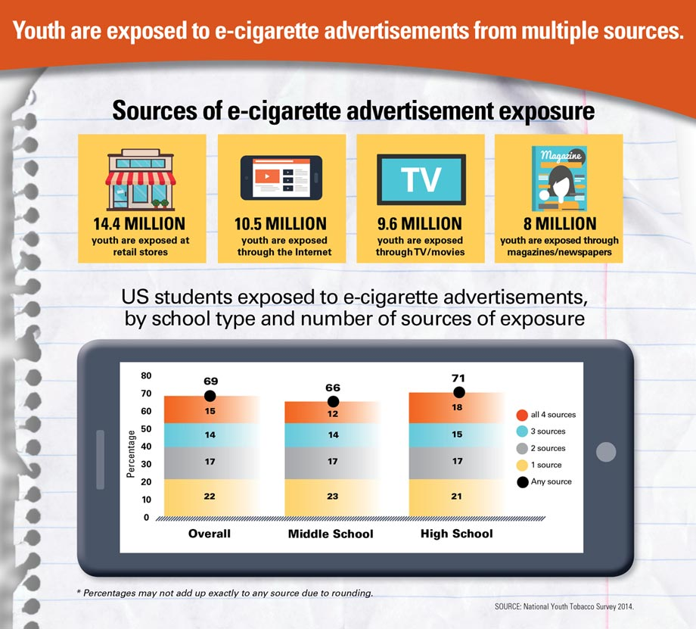
South Carolina Department of Alcohol and Other Drug Abuse Services
Notes:
In order for us to be able to reduce the burden on health caused by alcohol misuse and abuse, we need to know what data we have to determine the problems that are present in our public health system.

Slide 7
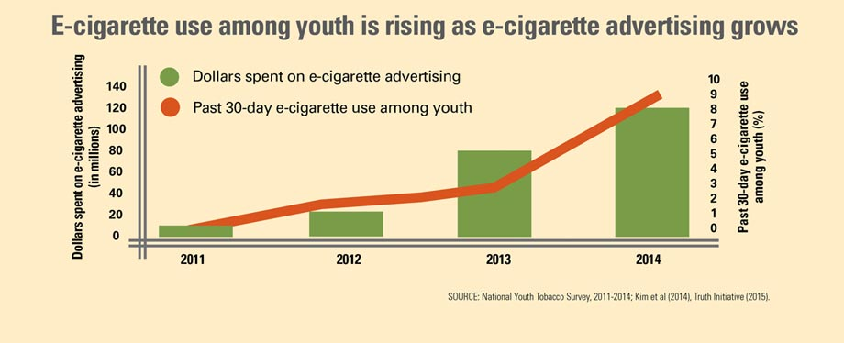
South Carolina Department of Alcohol and Other Drug Abuse Services
Notes:
In order for us to be able to reduce the burden on health caused by alcohol misuse and abuse, we need to know what data we have to determine the problems that are present in our public health system.

Slide 8
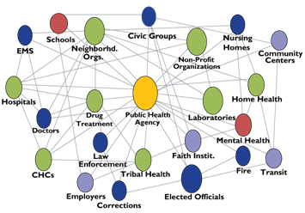
South Carolina Department of Alcohol and Other Drug Abuse Services
Public Health System:
Retail Environment
Source: Public Health Practice Program Office, Centers for Disease Control and Prevention , National Public Health Performance Standards Program, User Guide (first edition), 2002. (Current version available at www.cdc.gov/nphpsp)
Notes:
What makes a well-functioning public health system?
-Strong partnerships where partners recognize they are part of the public health system
-Effective channels of communication
-System-wide health objectives
-Resource sharing
-Leadership by governmental public health agency
-Feedback loops among state, local, tribal, territorial, and federal partners
Some of the essential services of public health are informing, educating, and empowering communities; mobilizing community partnerships; and developing policies and plans… These three services can yield environmental change at the POS.

Slide 9
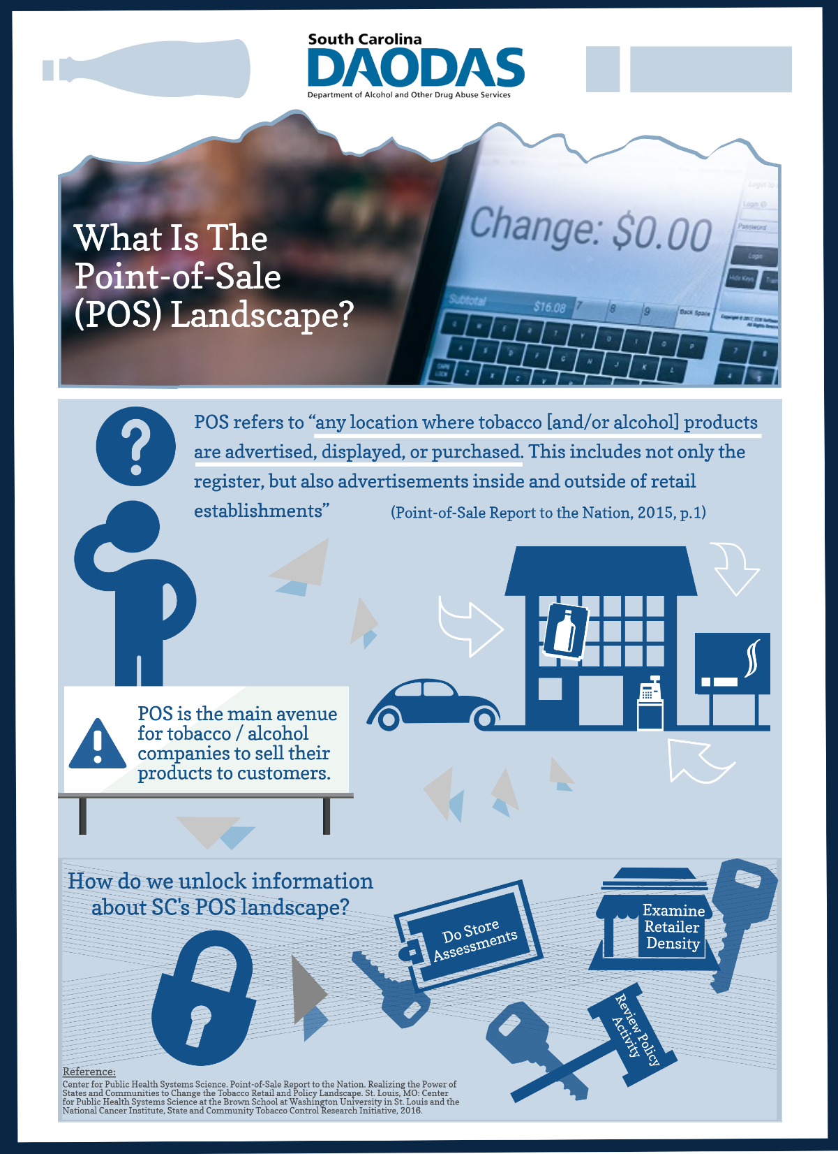
What is Point-of-Sale (POS) or Point-of-Purchase (POP)?
“any location where tobacco [and/or alcohol] products are advertised, displayed, or purchased. This includes not only the register, but also advertisements inside and outside of retail establishments” (Point-of-Sale Report to the Nation, 2015, p.1)
Notes:
Read: POS is the main avenue for tobacco/alcohol companies to sell their products to customers.

Slide 10
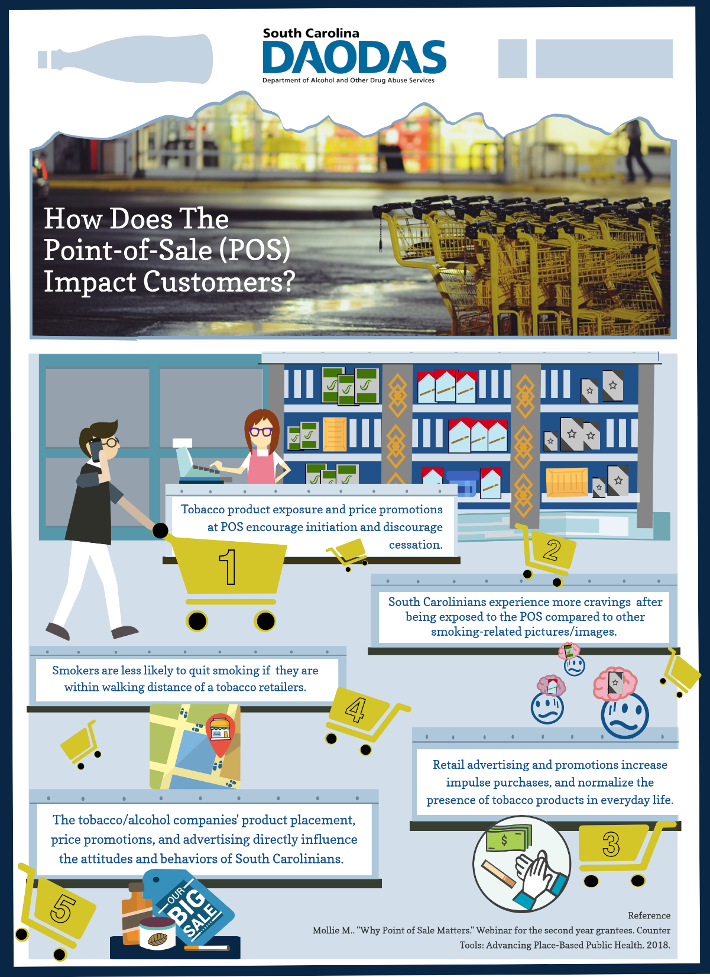
Notes:
Read: POS is the main avenue for tobacco/alcohol companies to sell their products to customers.

Slide 11

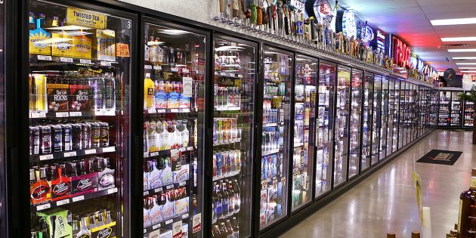
POS Landscapes Are Constantly Evolving
South Carolina Department of Alcohol and Other Drug Abuse Services
According to Nielsen Company fast-moving consumer goods (FMCG) brands and retailers data, the number of establishments that sold alcoholic beverages increased by more than 100,000 locations between 2007 and 2017.⁴
Post-recession growth; emergence of new products, technology, and distribution methods; and novel services have led to a diverse alcohol retail landscape.⁵
JUUL has a majority of the market share. Other electronic nicotine delivery systems makers are imitating JUUL products
Notes:
In order for us to be able to reduce the burden on health caused by alcohol misuse and abuse, we need to better understand how alcohol products are marketed (i.e., store exterior, store interior, and/or parking lot or other property advertising and/or alcohol-branded functional objects), where and how are alcohol products sold (e.g., store type to common locations – coolers, floor displays, shelves, ice-buckets, etc.), in what communities, and in what proximity to schools and parks.

Slide 12
DAODAS’s Goal – Reduce Underage Alcohol & Tobacco Use Among Youth In South Carolina
South Carolina Department of Alcohol and Other Drug Abuse Services
Utilizing data from the Counter Tools Project enhances DAODAS’s alcohol and tobacco outcome plan for South Carolina.
Gathering POS data helps prevention advocates inform and push for more comprehensive policies within and outside of the retail environment at the local and state level.
Notes:
We would like to see community advocates supporting limits on large/high alcohol content singles in coolers near the registers/entries to the establishments since this entices individuals that consume that product in the parking lot and then drive off impaired

Slide 13

DAODAS’s Vision – Applying the Strategic Prevention Framework (SPF)
South Carolina Department of Alcohol and Other Drug Abuse Services
After the POS plan/program is complete, practitioners can conduct the summative evaluation to determine the effect the POS plan/program had in terms of its outcome.
With the desired planning team in place, the local- and state-level practitioners can then plan the most appropriate culturally competent and sustainable POS intervention.
Conducting POS assessments gives local- and state- practitioners the ability to identify environmental risk factors and underage drinking problems that are present in communities
Next, practitioners can put their POS plan and intervention into place. While the plan and intervention are ongoing, the implementers can actively conduct a formative evaluation of the POS plan/program.
Once the local- and state-level practitioners prioritize their POS issue, they need to determine which community coalitions, organizations, faith-based groups, youth leadership teams, key stakeholders, etc. need to be included in the desired intervention.
(Substance Abuse and Mental…, December 1, 2017)
Notes:
The steps of SPF include:
Step 1: Assess Needs – determine what is the problem, and how can I learn more?
Step 2: Build Capacity – What do I have to work with?
Step 3: Plan – What should I do and how should I do it?
Step 4: Implement – How can I put my plan into action?
Provide practice ordinance examples of how to address these issues
Policy Domain Areas:
Licensing & Density (establish or increase licensing fees, limit or cap total number of licenses in a specific area, restrict retailers from operating within a certain distance of other retailers, restrict retailers in certain zones (e.g., residential zones), limit number of hours or days for sales)
Advertising (limit the time (of day) when advertising is permitted, limit the placement of ads at certain store locations (e.g., near youth locales), limit placement of ads inside stores (e.g., near cash registers), limit placement of outdoor ads, ban certain manners of advertising (e.g., outdoor sandwich board-style ads), establish content-neutral advertising restrictions (e.g., 15% of window space))
Non-tax price increases (ban price discounting, ban redemption and/or distribution of coupons, require disclosure of manufacturer incentives for retailers (i.e., sunshine law)
Product placement (ban product displays (i.e., require products to be stored out of view), restrict the number of products that can be displayed (e.g., one sample of each), limit times during which product displays are visible (e.g., after school hours))

Slide 14
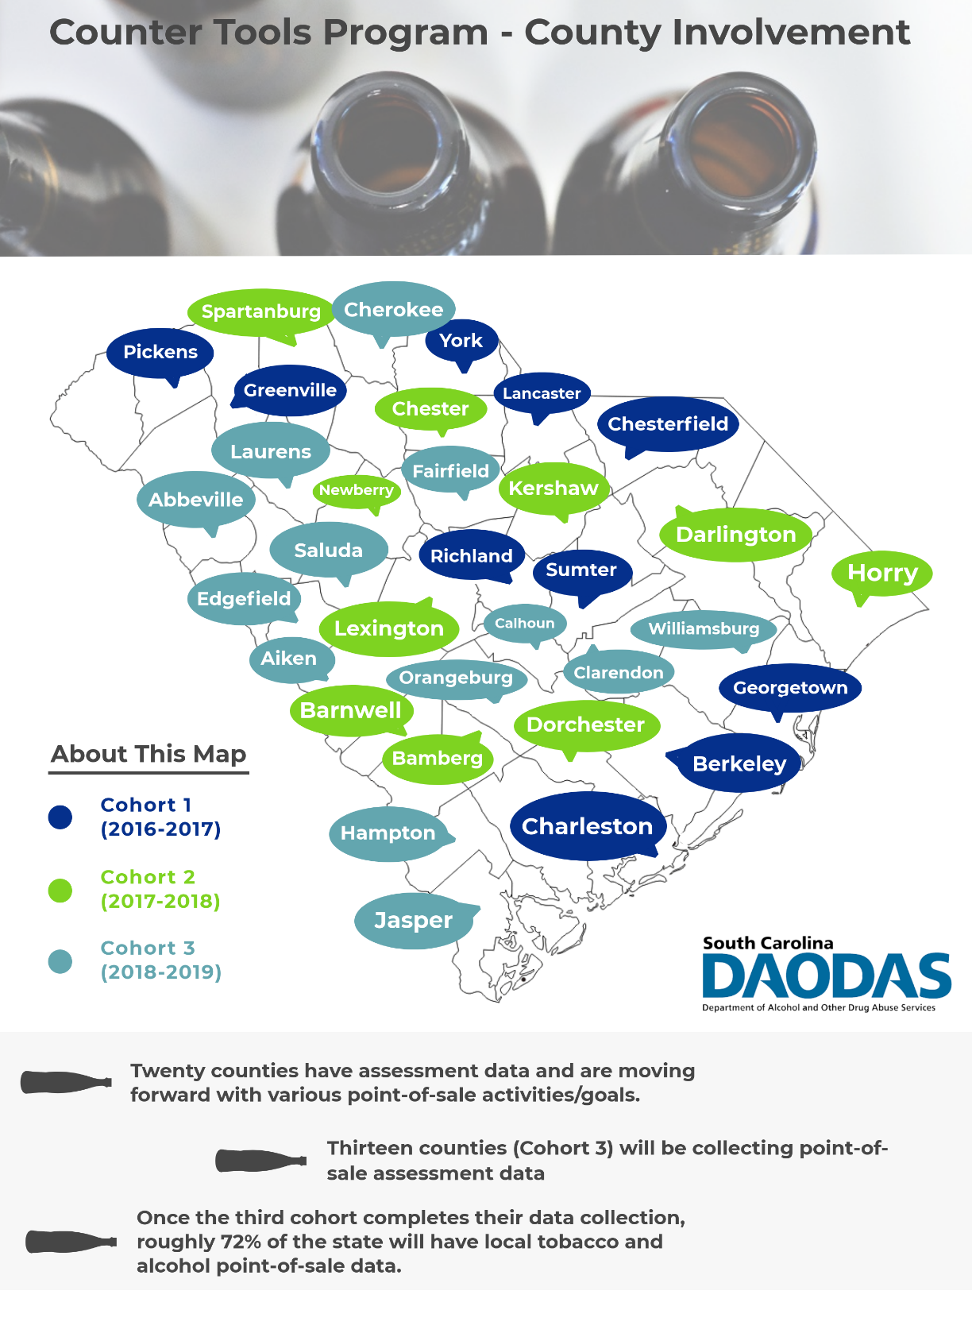
What Progress Have We Made?

Slide 15
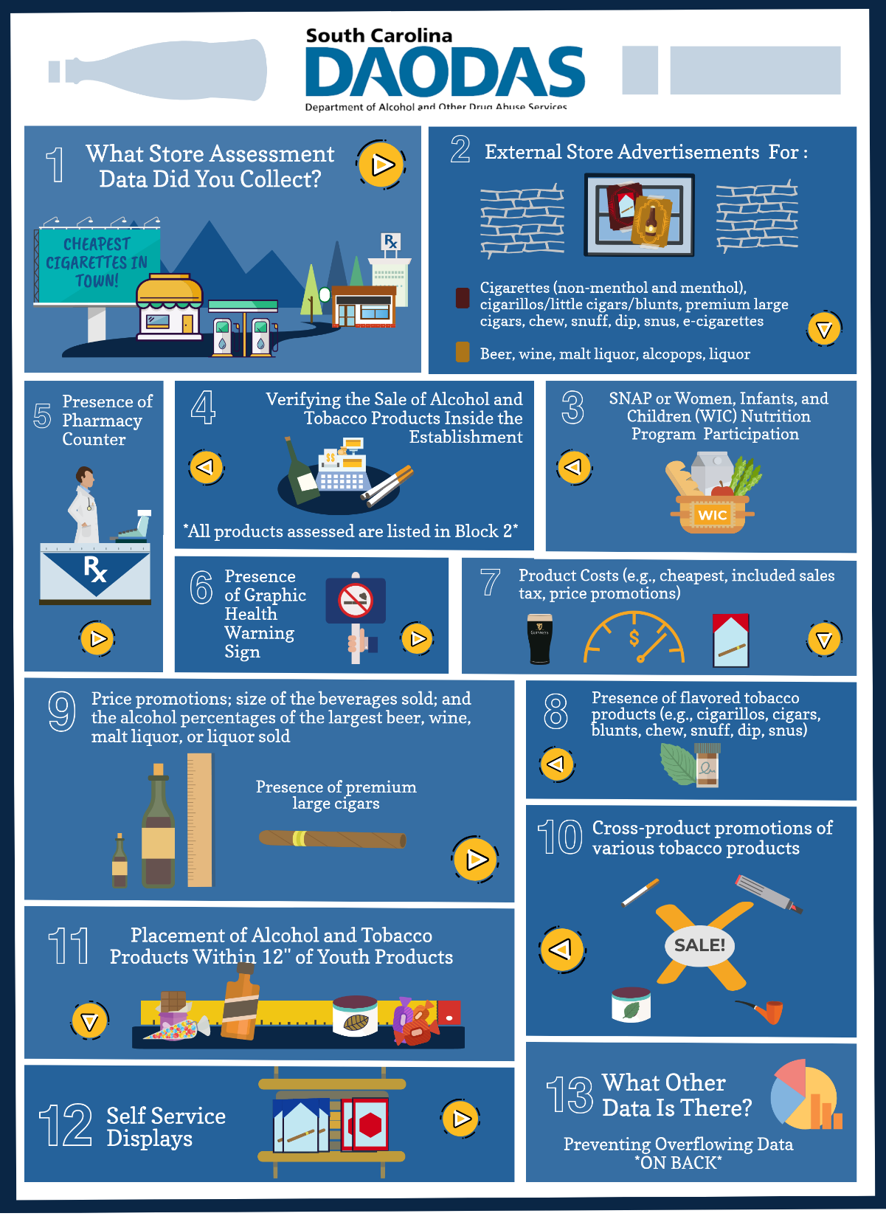
Notes:
What store assessment data do we have?
-Retailer Density – look at the county’s density and compare it to the state average; look at the retailer density in the desired county and rank the data and see what the top 20 counties are compared to your desired county; look at retailer density disparities by race, age, and income
-Access – (more tobacco-driven than alcohol)… FDA compliance data on check failures, ordinal data, and disparity data
-Pharmacies – can look at the % of retailers with a pharmacy… look at desired county and state average, look at the ordinal data, disparities data
-Proximity – look at the % of retailers within 500’ of another (compare to state average and compare to the top 10-20 counties), look at the % of retailers within 500’ of another in communities of color and other minorities, age discrepancies, and income disparities.
- Youth - % of retailers within 1000’ of schools and/or parks (higher or lower than the state average, in the top 10-20 counties) and look at any disparities by race, age, and/or income.

Slide 16
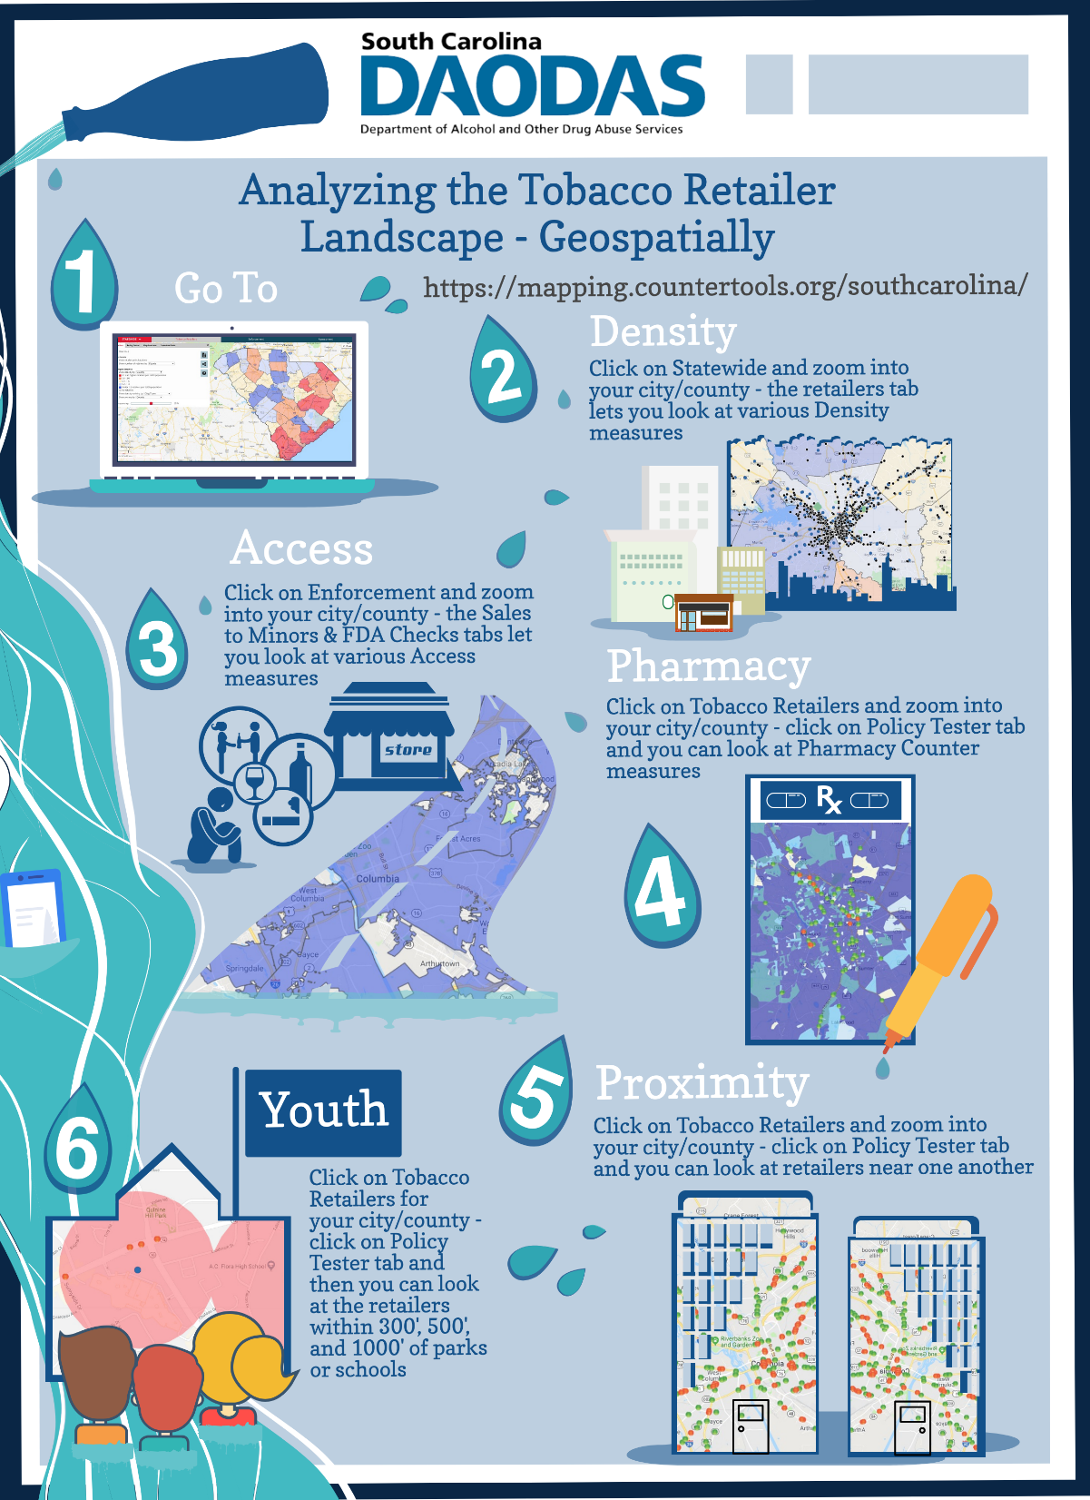
What data do we look at?
Notes:
Think SES factors in my community. What is the make-up of my community? Based on point of sale literature, we know that ethnic/minority communities may deal with more cigarillos or menthol, price promotions, density, etc.
If you don’t know where to start… you can look at broad area reports and go smaller.

Slide 17
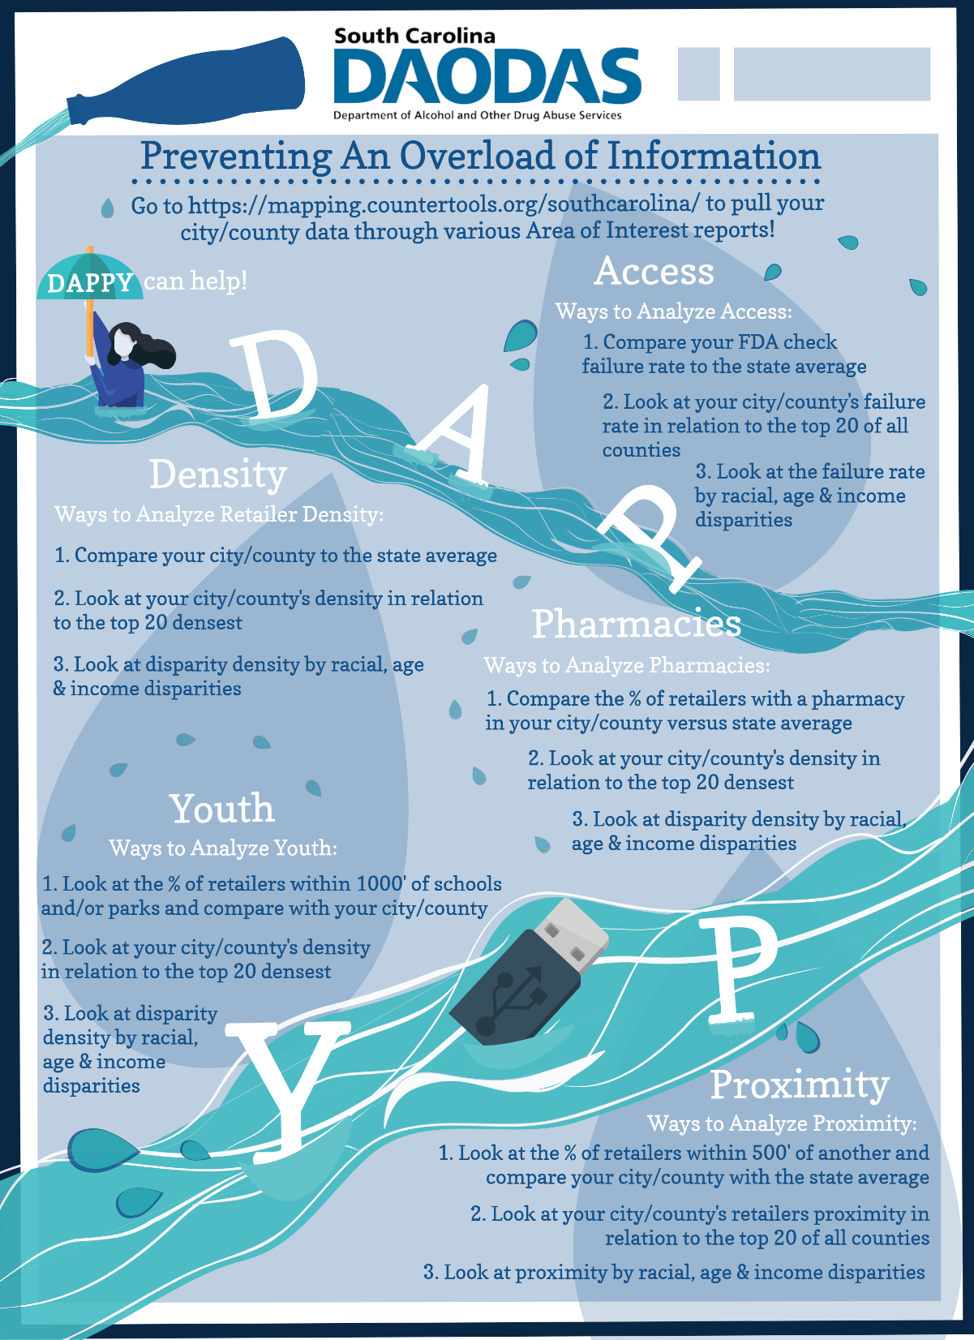

Slide 18
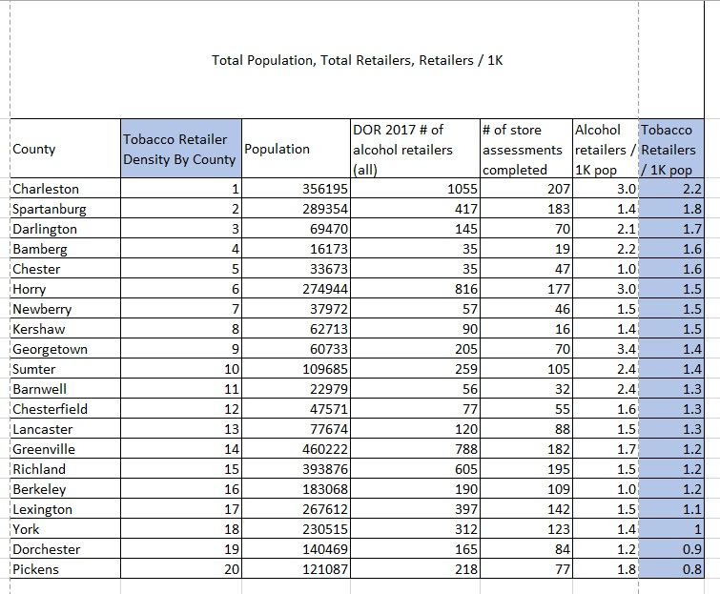
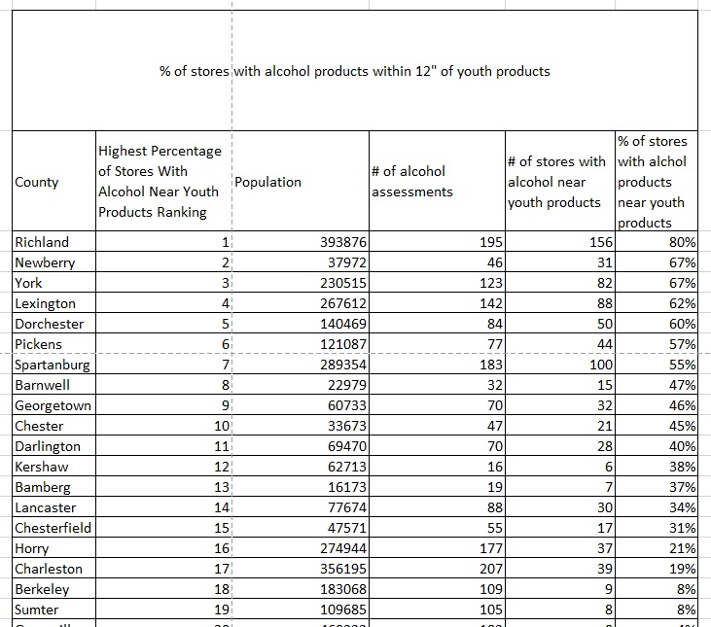
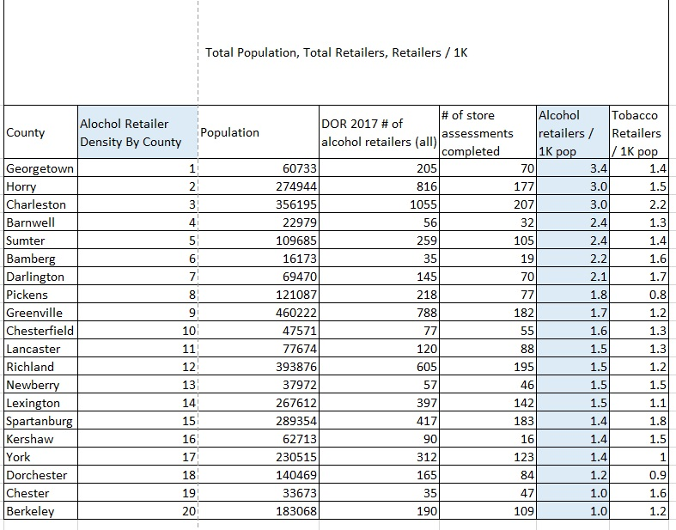
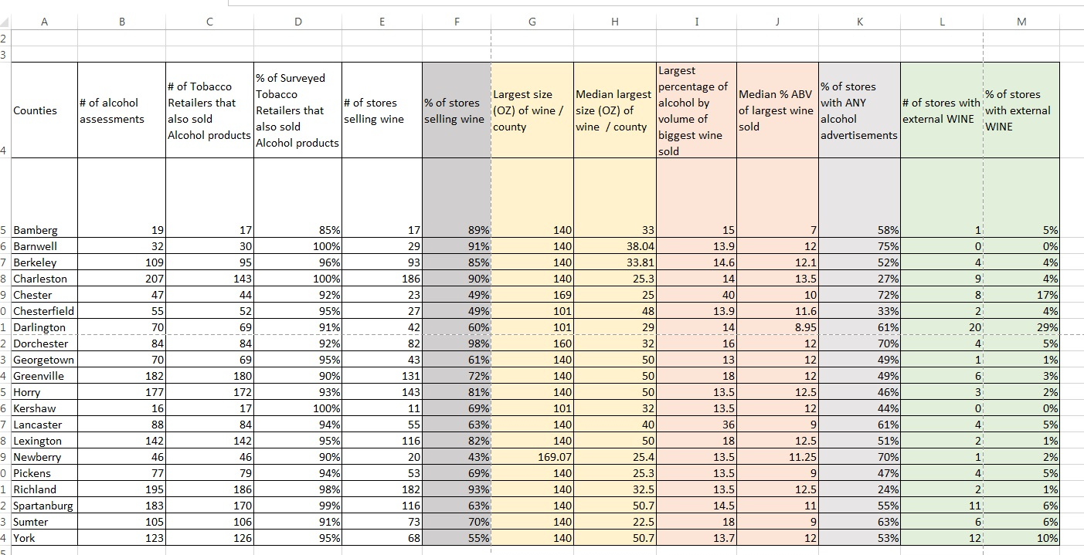
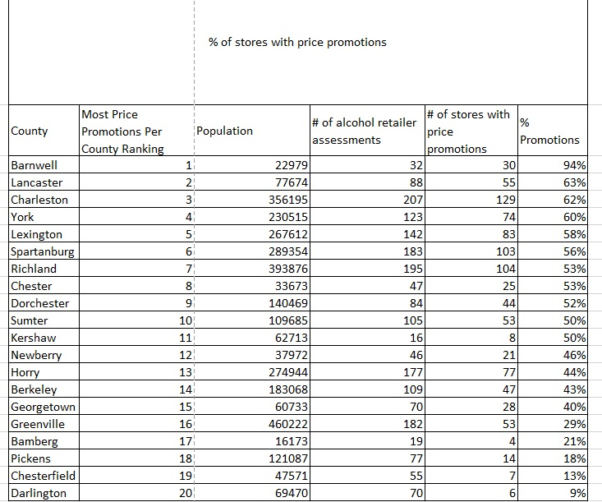
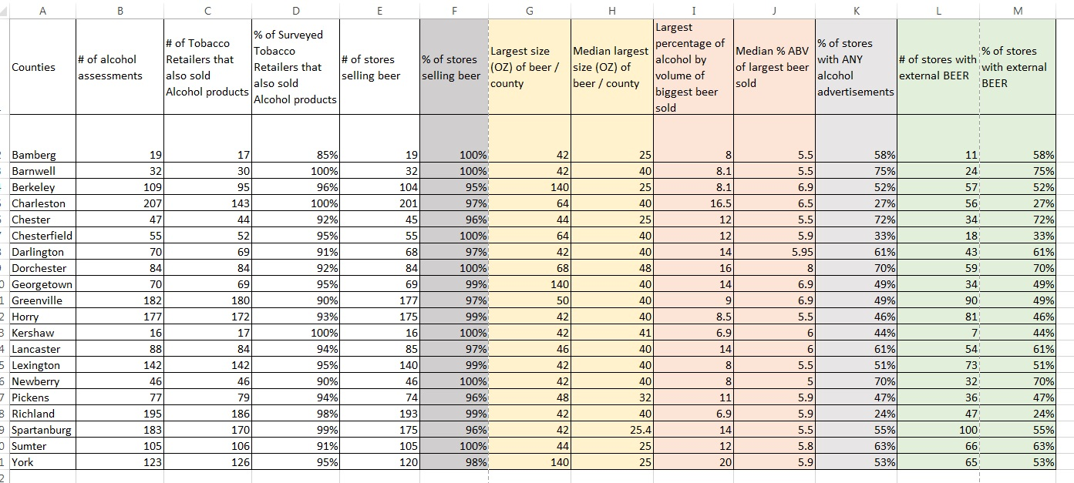
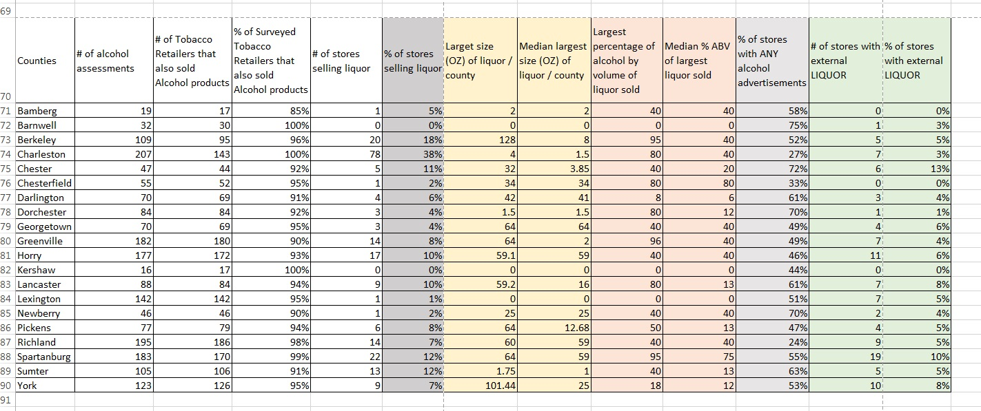
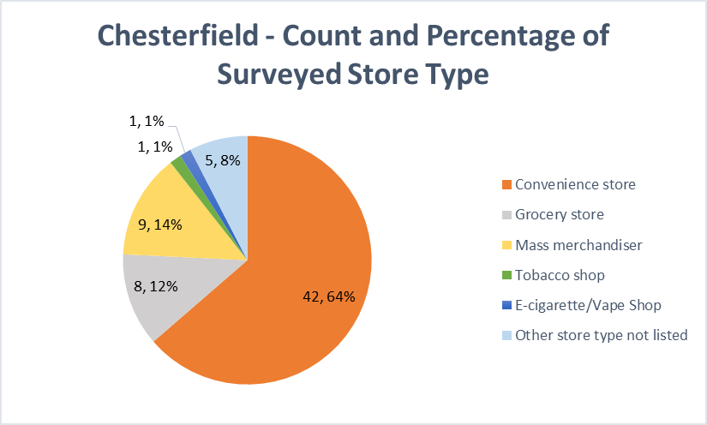
What POS Data Will Your County Collect?
South Carolina Department of Alcohol and Other Drug Abuse Services
Notes:
High alcohol outlet density, defined as a high concentration of retail alcohol outlets in a small area, is known to be an environmental risk factor for excessive drinking. To prevent excessive drinking, the Community Preventive Services Task Force recommends “limiting alcohol outlet density through the use of regulatory authority (e.g., licensing and zoning), which is based on strong evidence of intervention effectiveness.”
Alcohol outlet density varies widely among states and communities. Therefore, surveillance is needed to assess alcohol outlet density and to guide the development of public health interventions for reducing alcohol outlet density. For example, DOR personnel could use the information about the alcohol outlet density to limit the issuance of new alcohol licenses, or our
Alcohol Enforcement Teams could use this information to increase enforcement of liquor laws in a particular area. Information about alcohol outlet density could also be used by local governments to develop zoning regulations to regulate alcohol outlet density.
Let’s conclude with the alcohol point-of-sale policies that are effective.
I think this information is a great start, but I would love to do a deeper dive in the data. With this point-of-sale data will allow us at the local and state level to look at the alcohol retail environment and better understand alcohol-related health outcomes/disparities. I would look at the density of alcohol retailers per census tract versus county level. Look at urban versus rural census tracts. Based on a systematic review of scientific evidence on the effectiveness of regulating alcohol outlet density, there was strong evidence that regulating alcohol outlet density is one of the most effective strategies for reducing excessive alcohol consumption and related harms.

Slide 19
Alcohol Retailer Density
South Carolina Department of Alcohol and Other Drug Abuse Services
Notes:
Questions

Slide 20
Tobacco Retailer Density
South Carolina Department of Alcohol and Other Drug Abuse Services
Notes:
Questions

Slide 21
Cleaning Demonstration – Alcohol POS Data
South Carolina Department of Alcohol and Other Drug Abuse Services
Notes:
Question 4

Slide 22
Cleaning Demonstration – Alcohol POS Data
South Carolina Department of Alcohol and Other Drug Abuse Services
Notes:
Questions 7&9,16 – 16n

Slide 23
Alcohol Beverages Near Youth Products
South Carolina Department of Alcohol and Other Drug Abuse Services
Notes:
Questions 16 – 16n

Slide 24
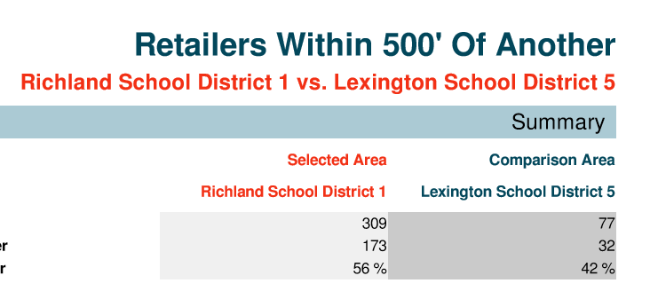
SC Store Mapper Reports
South Carolina Department of Alcohol and Other Drug Abuse Services
Notes:
When you sort a set of data and divide it into equal parts so that each part contains the same number of values, these cut-off points are called quantiles.
For instance, when a set of data is divided into five equal parts, each of them is called a quintile, which refers both to the cut-off points as well as the group of values contained. When a set of data is divided into ten equal parts, each of them is called a decile.
Example
In the field of income statistics, quintiles are used to find out how income is distributed among the population. To illustrate this, the population is first divided into five equal parts depending on their level of income: the first quintile contains the bottom fifth of the population on the income scale (i.e. the 20 % of the population with the lowest income), the second quintile represents the second fifth (from 20 % to 40 %) etc.; and the fifth quintile represents the 20 % of the population with the highest income.

Slide 25
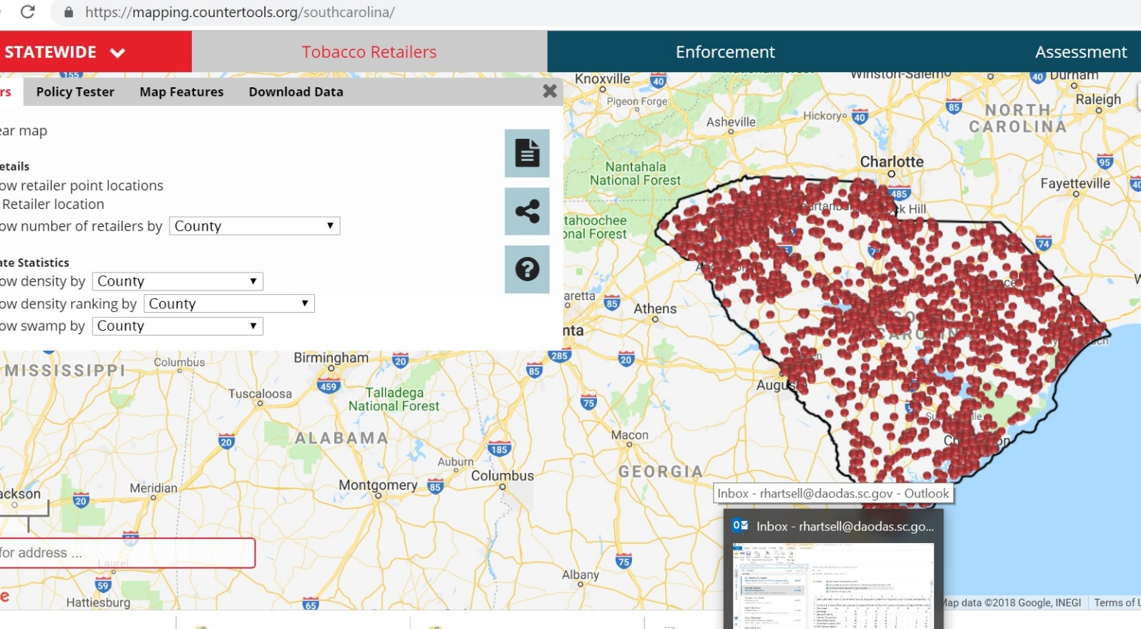
SC Store Mapper – Geospatial Component
South Carolina Department of Alcohol and Other Drug Abuse Services
Notes:
When you sort a set of data and divide it into equal parts so that each part contains the same number of values, these cut-off points are called quantiles.
For instance, when a set of data is divided into five equal parts, each of them is called a quintile, which refers both to the cut-off points as well as the group of values contained. When a set of data is divided into ten equal parts, each of them is called a decile.
Example
In the field of income statistics, quintiles are used to find out how income is distributed among the population. To illustrate this, the population is first divided into five equal parts depending on their level of income: the first quintile contains the bottom fifth of the population on the income scale (i.e. the 20 % of the population with the lowest income), the second quintile represents the second fifth (from 20 % to 40 %) etc.; and the fifth quintile represents the 20 % of the population with the highest income.

Slide 26
What Alcohol POS Policies Are Effective?
South Carolina Department of Alcohol and Other Drug Abuse Services
Pricing policies include alcohol excise tax (state)⁶
Retail price restrictions6
Physical availability policies include outlet density⁶
Minimum legal drinking age laws⁶
Hours of sale restrictions; days of sale restriction (Sunday sales)⁶
Bans on alcohol sales⁶
Direct shipment of alcohol to consumers restricted⁶
Compliance checks (enforcement of MLDA laws) ⁶
Local authority to regulate retail alcohol availability (preemption/conditional-use permits); ABCs present; functional; adequately staffed; local option permissible; credit card sales of alcohol prohibited⁶
Retail alcohol license policy. Drinking and driving policies include zero-tolerance laws, graduated driver license laws; administrative license revocation; use alcohol/lose license (youth); ignition interlock laws for DUI offenders; BAC 0.08/per se laws; sobriety checkpoints⁶
Promotion policies include retail signage restrictions, warning labels on alcohol products, counter marketing campaigns for alcohol, restrictions on mass media alcohol advertising exposure, nutrition information-labels, FAS warning signs, promotional material and giveaway restrictions, and outdoor advertising restrictions. ⁶
Notes:
High alcohol outlet density, defined as a high concentration of retail alcohol outlets in a small area, is known to be an environmental risk factor for excessive drinking. To prevent excessive drinking, the Community Preventive Services Task Force recommends “limiting alcohol outlet density through the use of regulatory authority (e.g., licensing and zoning), which is based on strong evidence of intervention effectiveness.”
Alcohol outlet density varies widely among states and communities. Therefore, surveillance is needed to assess alcohol outlet density and to guide the development of public health interventions for reducing alcohol outlet density. For example, DOR could use the information about the alcohol outlet density to limit the issuance of new alcohol licenses, or SLED to increase enforcement of liquor laws in a particular area. Information about alcohol outlet density could also be used by local governments to develop zoning regulations to regulate alcohol outlet density.
-Guide for Measuring Alcohol Outlet Density

Slide 27
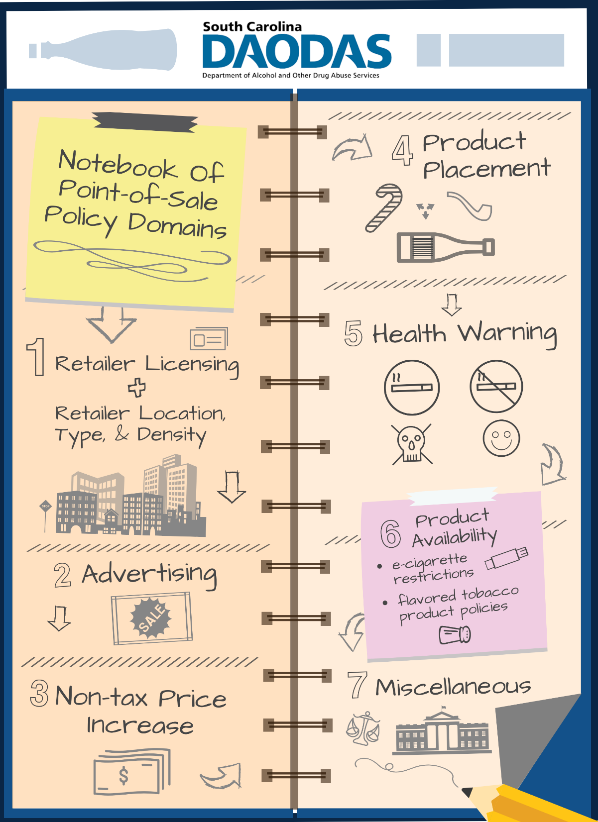
What Tobacco POS Policies Are Effective?

Slide 28

What Tobacco POS Policies Are Effective?
South Carolina Department of Alcohol and Other Drug Abuse Services
1. Retailer Licensing and Retailer Location, Type, and Density
  Establishing a licensing system with fees or increasing licensing fees
  Reducing the number of tobacco retail outlets
  Restricting the location of tobacco retail outlets
  Requiring a minimum distance between tobacco retail outlets
  Prohibiting the sale of tobacco products at types of establishments
Advertising
  Implementing content-neutral advertising laws
Notes:
High alcohol outlet density, defined as a high concentration of retail alcohol outlets in a small area, is known to be an environmental risk factor for excessive drinking. To prevent excessive drinking, the Community Preventive Services Task Force recommends “limiting alcohol outlet density through the use of regulatory authority (e.g., licensing and zoning), which is based on strong evidence of intervention effectiveness.”
Alcohol outlet density varies widely among states and communities. Therefore, surveillance is needed to assess alcohol outlet density and to guide the development of public health interventions for reducing alcohol outlet density. For example, DOR could use the information about the alcohol outlet density to limit the issuance of new alcohol licenses, or SLED to increase enforcement of liquor laws in a particular area. Information about alcohol outlet density could also be used by local governments to develop zoning regulations to regulate alcohol outlet density.
-Guide for Measuring Alcohol Outlet Density

Slide 29
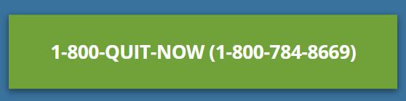
What Tobacco POS Policies Are Effective?
South Carolina Department of Alcohol and Other Drug Abuse Services
3. Non-Tax Price Increase
  Establishing minimum price laws
  Prohibiting price discounting
  Restricting sale based on pack size for non-cigarette tobacco products
4. Product Placement
  Prohibiting self-service access to non-cigarette tobacco products
5. Health Warning
  Require the posting of quitline information
  Require the posting of health warnings at hookah lounges
6. Product Availability
  Prohibiting the sale of flavored non-cigarette tobacco products
Notes:
High alcohol outlet density, defined as a high concentration of retail alcohol outlets in a small area, is known to be an environmental risk factor for excessive drinking. To prevent excessive drinking, the Community Preventive Services Task Force recommends “limiting alcohol outlet density through the use of regulatory authority (e.g., licensing and zoning), which is based on strong evidence of intervention effectiveness.”
Alcohol outlet density varies widely among states and communities. Therefore, surveillance is needed to assess alcohol outlet density and to guide the development of public health interventions for reducing alcohol outlet density. For example, DOR could use the information about the alcohol outlet density to limit the issuance of new alcohol licenses, or SLED to increase enforcement of liquor laws in a particular area. Information about alcohol outlet density could also be used by local governments to develop zoning regulations to regulate alcohol outlet density.
-Guide for Measuring Alcohol Outlet Density

Slide 30
Ideas for Using Your Point-of-Sale Dollars
South Carolina Department of Alcohol and Other Drug Abuse Services
Assessing community awareness of point-of-sale issues/disparities in your community
Media advocacy or social marketing and health communication.
Youth anti-tobacco activities (i.e., point-of-sale anti-tobacco activities)
Point-of-sale findings and merchant education on these findings
Rewards program(s) for merchants and law enforcement who positively modify the point-of-sale environment
Working with PREP merchants/business owners/managers on an informal agreement about moving certain products in their store
For working with school districts - definitely another good place to share assessment results and the impact that point of sale marketing and promotions have on youth.
Meeting with your decision makers (city/county council) - to share the results of your point-of-sale assessments
  make them aware of different policy solutions,
  assess their opinion/viewpoint on those potential interventions
Reach out other stakeholders to talk to them about point of sale
  groups working on health, equity, planning, beautification, etc.
  business groups/chamber of commerce, fire dept., police dept., etc.
Notes:
High alcohol outlet density, defined as a high concentration of retail alcohol outlets in a small area, is known to be an environmental risk factor for excessive drinking. To prevent excessive drinking, the Community Preventive Services Task Force recommends “limiting alcohol outlet density through the use of regulatory authority (e.g., licensing and zoning), which is based on strong evidence of intervention effectiveness.”
Alcohol outlet density varies widely among states and communities. Therefore, surveillance is needed to assess alcohol outlet density and to guide the development of public health interventions for reducing alcohol outlet density. For example, DOR could use the information about the alcohol outlet density to limit the issuance of new alcohol licenses, or SLED to increase enforcement of liquor laws in a particular area. Information about alcohol outlet density could also be used by local governments to develop zoning regulations to regulate alcohol outlet density.
-Guide for Measuring Alcohol Outlet Density

Slide 31
Ideas for Using Your Point-of-Sale Dollars
South Carolina Department of Alcohol and Other Drug Abuse Services
Reduce youth access to tobacco (e.g., compliance checks, working with law enforcement, educating local school districts on this information and JUULs, or working with PREP merchants/business owners/managers on an informal agreement about moving certain products in their store so that they aren’t at children’s heights or near youth products, etc.) -
For working with school districts - definitely another good place to share assessment results and the impact that point of sale marketing and promotions have on youth.
For working with retailers, I think it might also be helpful to focus on a more formal agreement with the retailer (e.g. like the retailer rewards/recognition program you suggested above) having the retailer sign a pledge saying that they will remove ads below three feet, remove self-service items, etc. and giving formal recognition to the retailers that participate (e.g. a newspaper article, a sticker on their door, etc.).
Meeting with your decision makers (city/county council) - to share the results of your point-of-sale assessments, make them aware of different policy solutions, and assess their opinion/viewpoint on those potential interventions
Reach out other stakeholders (e.g. other groups working on health, equity, planning, beautification, etc. business groups/chamber of commerce, fire dept., police dept., etc.) to talk to them about point of sale
Often, enforcement activities (e.g. compliance checks for sales to minors) are seen as a separate activity from point-of-sale tobacco control work (though clearly, enforcement of POS policies has to happen and it's helpful if those efforts are integrated). Some states have a pretty stark division between "prevention" and "enforcement" efforts. Incentivizing point-of-sale enforcement like advertising ordinances.
Notes:
High alcohol outlet density, defined as a high concentration of retail alcohol outlets in a small area, is known to be an environmental risk factor for excessive drinking. To prevent excessive drinking, the Community Preventive Services Task Force recommends “limiting alcohol outlet density through the use of regulatory authority (e.g., licensing and zoning), which is based on strong evidence of intervention effectiveness.”
Alcohol outlet density varies widely among states and communities. Therefore, surveillance is needed to assess alcohol outlet density and to guide the development of public health interventions for reducing alcohol outlet density. For example, DOR could use the information about the alcohol outlet density to limit the issuance of new alcohol licenses, or SLED to increase enforcement of liquor laws in a particular area. Information about alcohol outlet density could also be used by local governments to develop zoning regulations to regulate alcohol outlet density.
-Guide for Measuring Alcohol Outlet Density

Slide 32



Ideas for Using Your Point-of-Sale Dollars
South Carolina Department of Alcohol and Other Drug Abuse Services
Reduce youth access to tobacco (e.g., compliance checks, working with law enforcement, educating local school districts on this information and JUULs, or working with PREP merchants/business owners/managers on an informal agreement about moving certain products in their store so that they aren’t at children’s heights or near youth products, etc.)
For working with school districts - definitely another good place to share assessment results and the impact that point of sale marketing and promotions have on youth.
For working with retailers, I think it might also be helpful to focus on a more formal agreement with the retailer (e.g. like the retailer rewards/recognition program you suggested above) having the retailer sign a pledge saying that they will remove ads below three feet, remove self-service items, etc. and giving formal recognition to the retailers that participate (e.g. a newspaper article, a sticker on their door, etc.).
Notes:
High alcohol outlet density, defined as a high concentration of retail alcohol outlets in a small area, is known to be an environmental risk factor for excessive drinking. To prevent excessive drinking, the Community Preventive Services Task Force recommends “limiting alcohol outlet density through the use of regulatory authority (e.g., licensing and zoning), which is based on strong evidence of intervention effectiveness.”
Alcohol outlet density varies widely among states and communities. Therefore, surveillance is needed to assess alcohol outlet density and to guide the development of public health interventions for reducing alcohol outlet density. For example, DOR could use the information about the alcohol outlet density to limit the issuance of new alcohol licenses, or SLED to increase enforcement of liquor laws in a particular area. Information about alcohol outlet density could also be used by local governments to develop zoning regulations to regulate alcohol outlet density.
-Guide for Measuring Alcohol Outlet Density

Slide 33


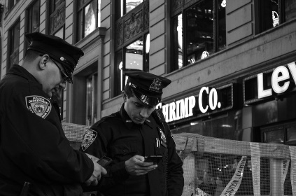
Ideas for Using Your Point-of-Sale Dollars
South Carolina Department of Alcohol and Other Drug Abuse Services
Meeting with your decision makers (city/county council) - to share the results of your point-of-sale assessments, make them aware of different policy solutions, and assess their opinion/viewpoint on those potential interventions
Reach out other stakeholders (e.g. other groups working on health, equity, planning, beautification, etc. business groups/chamber of commerce, fire dept., police dept., etc.) to talk to them about point of sale
Often, enforcement activities (e.g. compliance checks for sales to minors) are seen as a separate activity from point-of-sale tobacco control work (though clearly, enforcement of POS policies has to happen and it's helpful if those efforts are integrated). Some states have a pretty stark division between "prevention" and "enforcement" efforts. Incentivizing point-of-sale enforcement like advertising ordinances.
Notes:
High alcohol outlet density, defined as a high concentration of retail alcohol outlets in a small area, is known to be an environmental risk factor for excessive drinking. To prevent excessive drinking, the Community Preventive Services Task Force recommends “limiting alcohol outlet density through the use of regulatory authority (e.g., licensing and zoning), which is based on strong evidence of intervention effectiveness.”
Alcohol outlet density varies widely among states and communities. Therefore, surveillance is needed to assess alcohol outlet density and to guide the development of public health interventions for reducing alcohol outlet density. For example, DOR could use the information about the alcohol outlet density to limit the issuance of new alcohol licenses, or SLED to increase enforcement of liquor laws in a particular area. Information about alcohol outlet density could also be used by local governments to develop zoning regulations to regulate alcohol outlet density.
-Guide for Measuring Alcohol Outlet Density

Slide 34
References
South Carolina Department of Alcohol and Other Drug Abuse Services
Substance Abuse and Mental Health Services Administration (SAMHSA). 2015 National Survey on Drug Use and Health (NSDUH). Table 2.41B—Alcohol Use in Lifetime, Past Year, and Past Month among Persons Aged 12 or Older, by Demographic Characteristics: Percentages, 2014 and 2015. Available at: https://www.samhsa.gov/data/sites/default/files/NSDUH-DetTabs-2015/NSDUH-DetTabs-2015/NSDUH-DetTabs-2015.htm#tab2-41b. Accessed 1/18/17.
Substance Abuse and Mental Health Services Administration (SAMHSA). 2015 National Survey on Drug Use and Health (NSDUH). Table 5.5A—Substance Use Disorder in Past Year among Persons Aged 12 to 17, by Demographic Characteristics: Numbers in Thousands, 2014 and 2015. Available at: https://www.samhsa.gov/data/sites/default/files/NSDUH-DetTabs-2015/NSDUH-DetTabs-2015/NSDUH-DetTabs-2015.htm#tab5-5a. Accessed 1/18/17.
Substance Abuse and Mental Health Services Administration (SAMHSA). 2015 National Survey on Drug Use and Health (NSDUH). Table 5.6A—Substance Use Disorder in Past Year among Persons Aged 18 or Older, by Demographic Characteristics: Numbers in Thousands, 2014 and 2015. Available at: https://www.samhsa.gov/data/sites/default/files/NSDUH-DetTabs-2015/NSDUH-DetTabs-2015/NSDUH-DetTabs-2015.htm#tab5-6a. Accessed 1/18/17.
The Nielsen Company. (2016, April 24). Assessing the Reduced Growth of the U.S. Adult Beverage Market. Retrieved October 24, 2018, from https://www.nielsen.com/us/en/insights/news/2018/assessing-the-reduced-growth-of-the-us-adult-beverage-market.html
Beaudette, J. (2015, November 12). Overview Of The U.S. Beverage Alcohol Market, Trends & Market Entry Conditions [PDF]. The Gateway to Growth.Beverage Alcohol Community Symposium
Nelson, T. F., Xuan, Z., Babor, T. F., Brewer, R. D., Chaloupka, F. J., Gruenewald, P. J., . . . Naimi, T. S. (2013). Efficacy and the Strength of Evidence of U.S. Alcohol Control Policies. American Journal of Preventive Medicine, 45(1), 19-28. doi:10.1016/j.amepre.2013.03.008
Center for Public Health Systems Science. Point-of-Sale Report to the Nation: Realizing the Power of States and Communities to Change the Tobacco Retail and Policy Landscape. St. Louis, MO: Center for Public Health Systems Science at the Brown School at Washington University in St. Louis and the National Cancer Institute, State and Community Tobacco Control Research Initiative, 2016.
Department of Alcohol and Other Drug Abuse Services. (2017). Daodas block grant governing terms fy 2018. Columbia, SC.
Substance Abuse and Mental Health Services Administration. (December 1, 2017). Applying the strategic prevention framework (spf). Retrieved from https://www.samhsa.gov/capt/applying-strategic-prevention-framework

Slide 35
CONTACT US FOR MORE INFORMATION
South Carolina Department of Alcohol and Other Drug Abuse Services
Physical Address:
1801 Main Street, 4th Floor
Columbia, SC 29201
Phone:
803.896.5555
www.daodas.sc.gov

